Slide 1
Logo phone-number messenger
Search Destination.
Chittagong-Town,Bandarban,Sajek,Rangamati,Coxebazar-beach,Saintmartin Iceland, Mosque City of Bagherhat,Sundarbans,Jafhlong,Ratargulswamp forest,Sreemangal,
Kuakata.

Slide 2
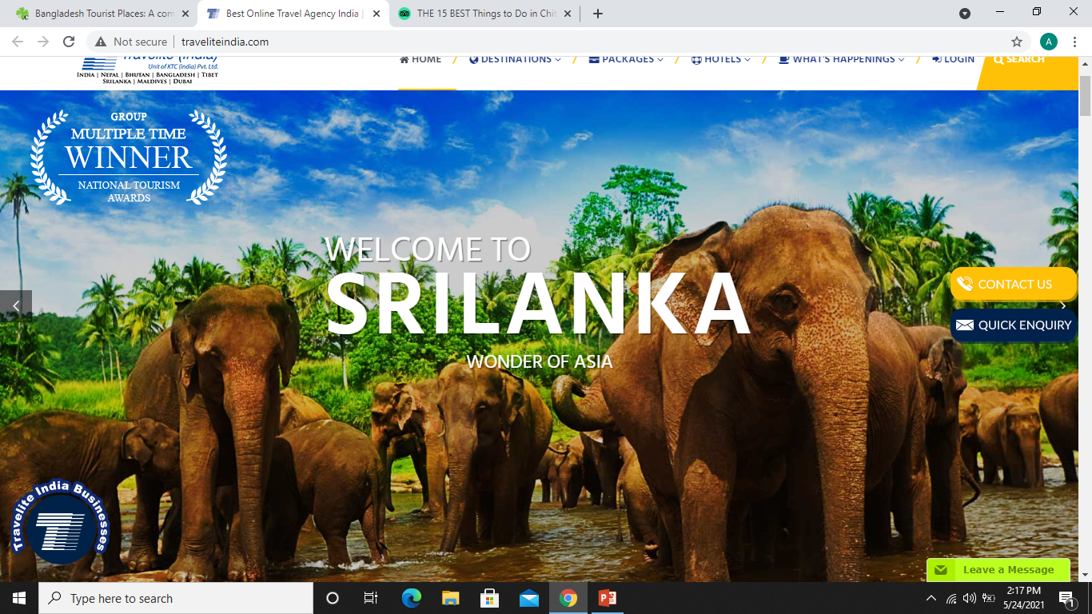
After Search Box: NEW offer.
There will be some adds. Like poster about some places,it will be slideshare.

Slide 3
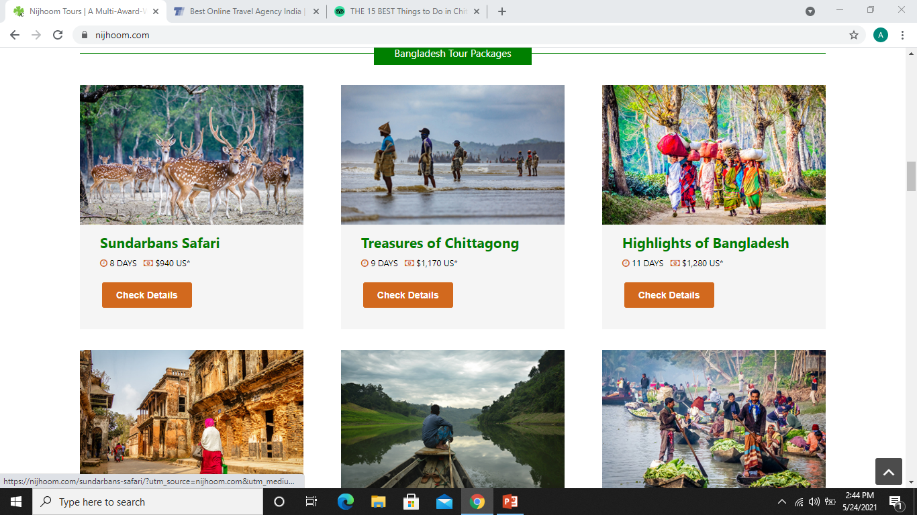
Trending Bangladesh Destination.
Example:
Coxbazar.. {img}
Saintmartins {img}
View offer.
View offer.

Slide 4
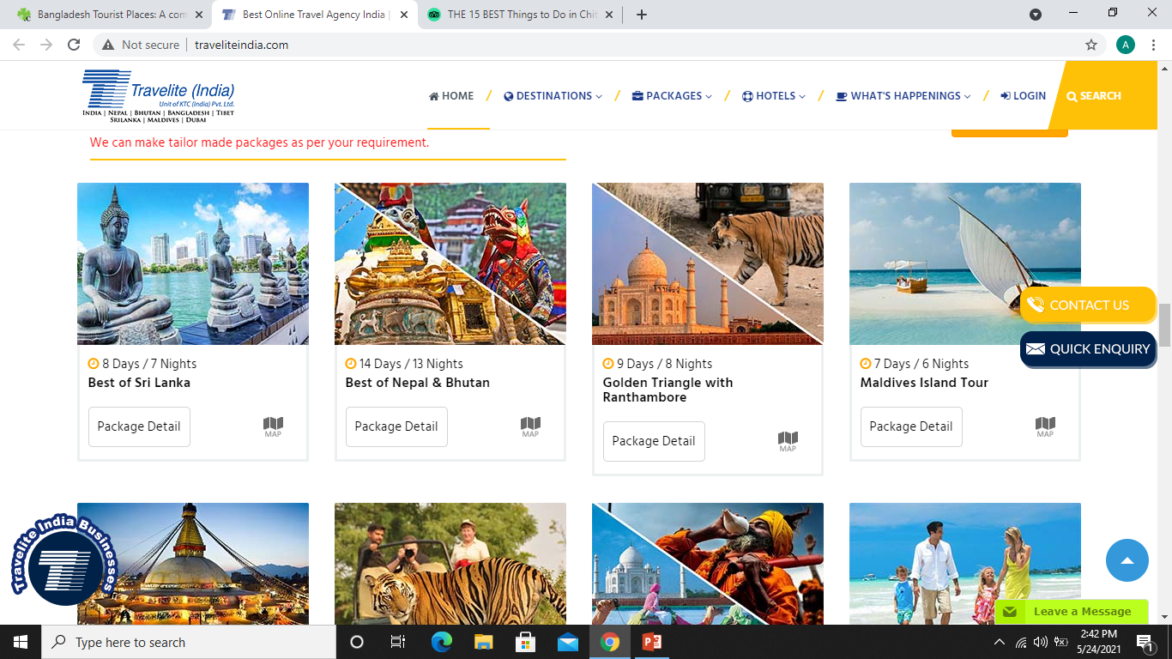
Most Populer Package
Tanchi{img}
Sreemangal{img}
View Package
View Package.

Slide 5
Student Package\Picnic
Fantasy.{img}
Sonargaon
View Offer
View offer.
Couple Package/Honeymoon
Gazipur Resort
Romantic Places.

Slide 6
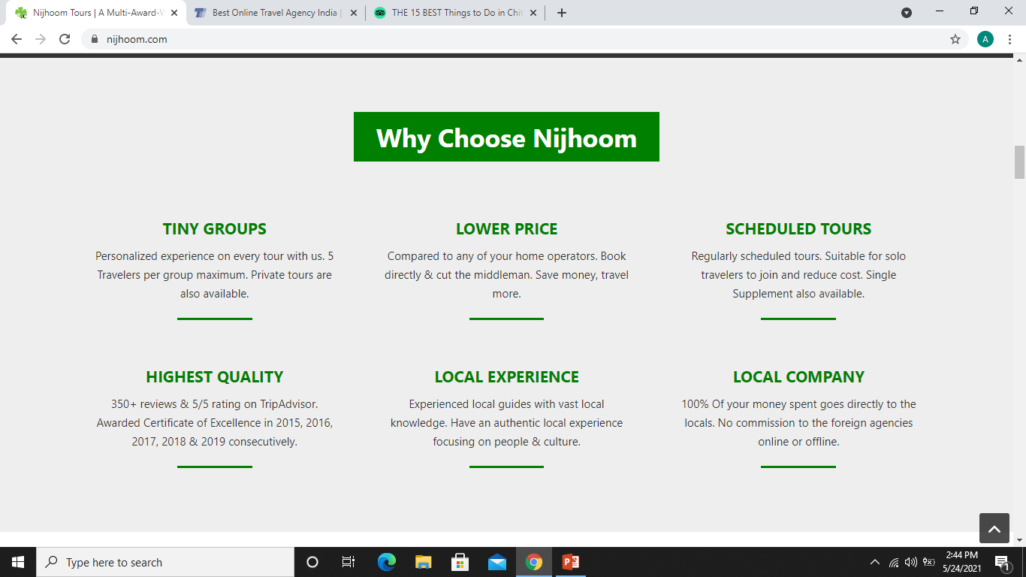
Why Nebula.com
Memorabl
Experiences
Trusted Advisor
Recognize &Connect.
Responsive
Ease

Slide 7
What our Client Says .
There will be some text uploaded and it must be slideshare.

Slide 8
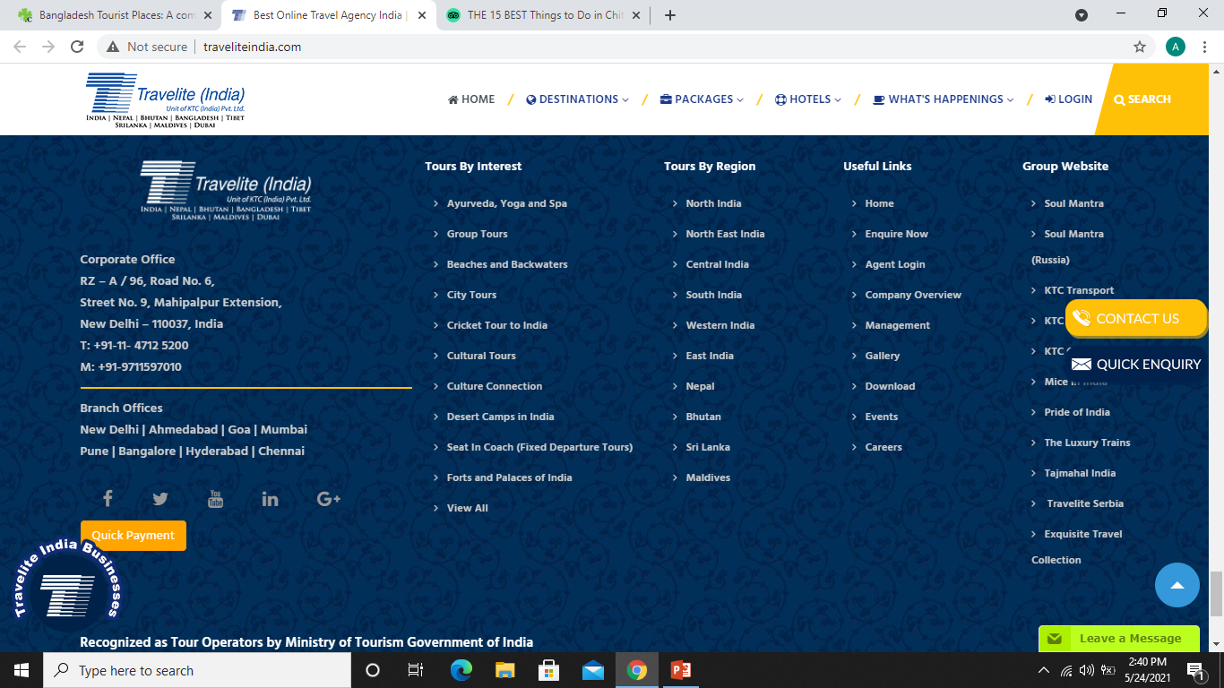
Footer End
Like this photo. Company Details

